Slide 1
Database agent: Chat with your SQL database
Harris Tan
31 May 2024

Slide 2
Table of contents
The opportunity
Exploring our SQL database
Building our agent
Demos
Rollout plan
Post-deployment

Slide 3
The opportunity

Slide 4




The problem
Our focal organisation is a mid-sized SaaS company (approximately 100 people) providing all-in-one HR software that lets customers manage payroll, benefits, performance management, attendance etc.
The organisation is divided into the product development team, data team, customer support team, sales and marketing team, and implementation and training team.
Data about subscriptions, customer profiles, customer employees and usage of various modules are stored in the company’s SQL database. Teams rely on dashboards built by the in-house data team to gain access to the data they need.
However, the adoption rate of these dashboards is low. The data team’s lack of understanding of the company’s business and the lack of coordination between the various teams have resulted in dashboards that do not meet the needs of most stakeholders. As a result, they would often submit ad hoc data requests to the data team.
However, as the data team is extremely lean, it is inundated with requests and each request is added to a backlog. It can take multiple days for the data team to resolve a request, by which time the data requester is likely to have “missed the opportunity”.

Slide 5
Our solution
We propose to develop a chatbot that allows any user to query the company’s database using natural language instead of SQL
Stronger employee engagement
Direct cost savings
Value of time saved from the data team due to reduced handling of adhoc data requests and maintenance of dashboards. Reduction in subscription fees to BI software providers (eg Tableau)
Creating an environment of data transparency and empowering team members with the tools to access data independently can improve employee engagement, leading to a more motivated workforce
⁠Greater capacity for innovation
Higher productivity and
improved decision-making
Team members gain more access to data and can develop a deeper and more holistic understanding of the business. As a result, they are better positioned to come up with innovative ideas that can create value for the organisation.
Instant access to accurate and relevant data allows team members to make informed decisions quickly, leading to better business outcomes

Slide 6
Exploring our SQL database

Slide 7
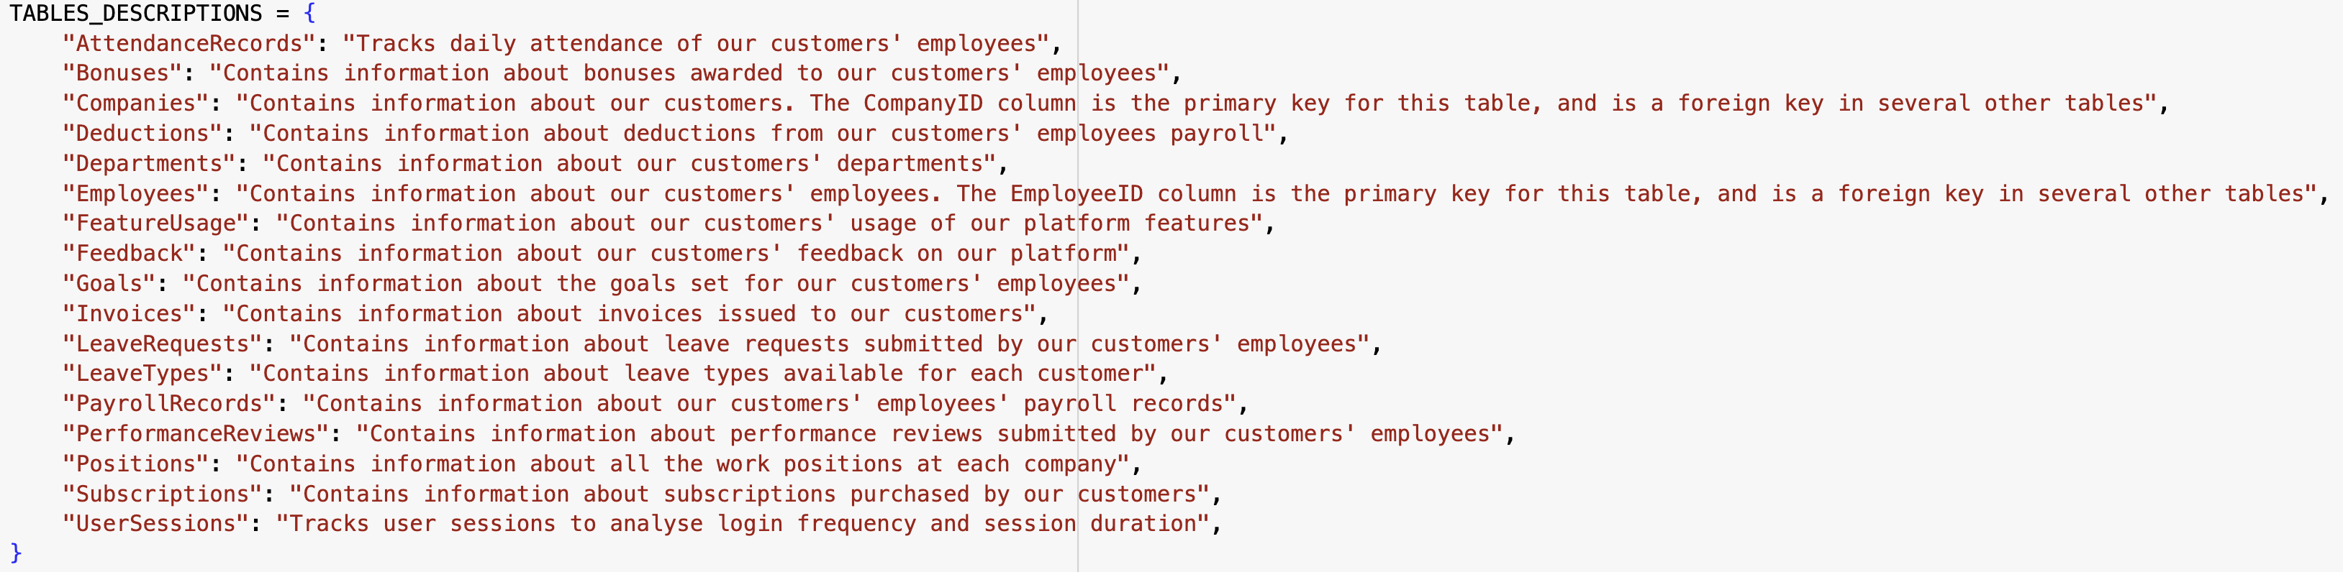
The contents of our database
For this project, we have created a synthetic SQLite database that is designed to resemble a real-world database for a typical HR SaaS company. There are 17 tables in total.
The database allows for a wide range of possible queries, from simple single-table queries to complex multi-table queries. It will provide a comprehensive and robust test of our chatbot's abilities.
Descriptions of each table:

Slide 8
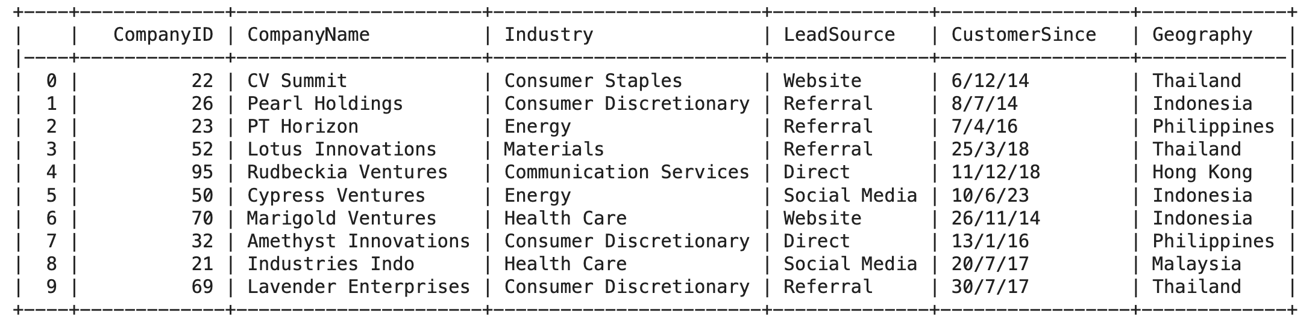
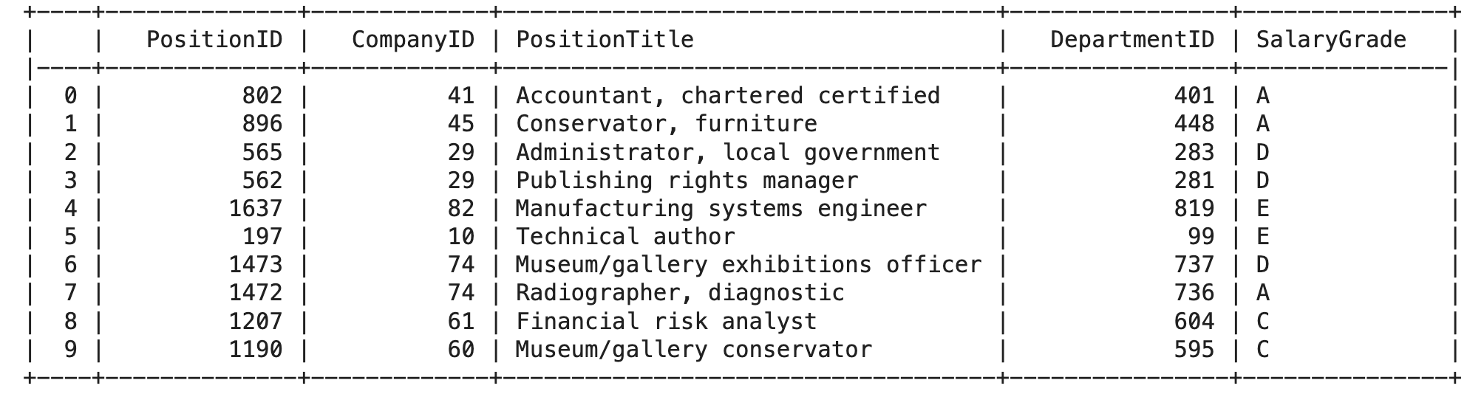
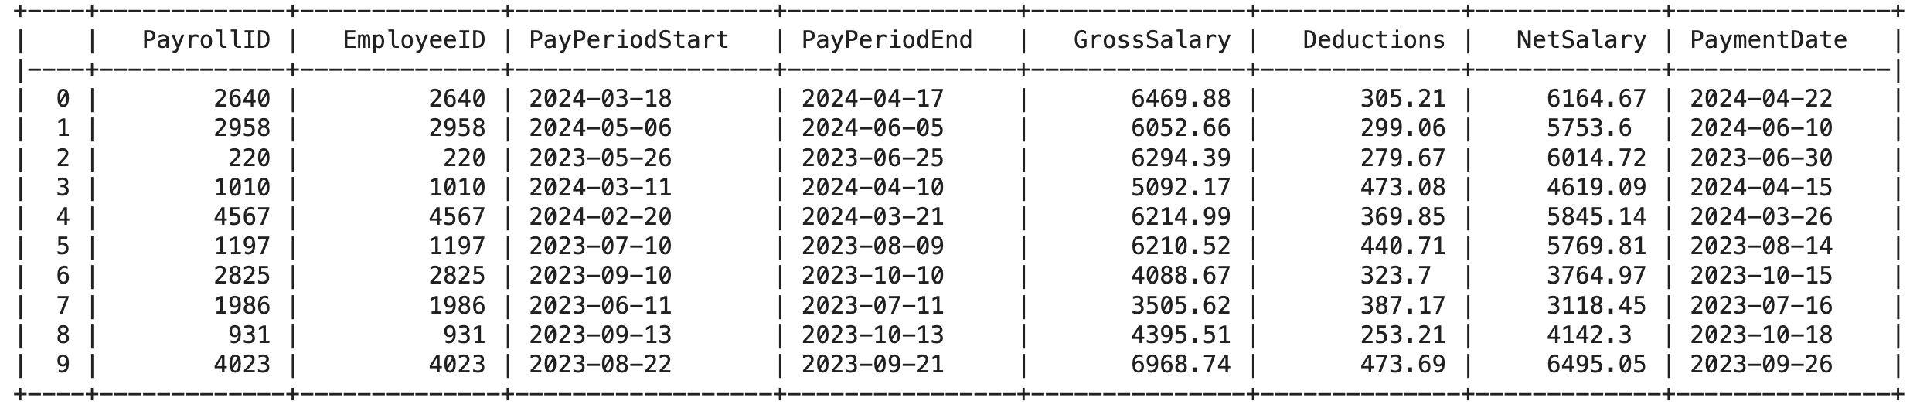
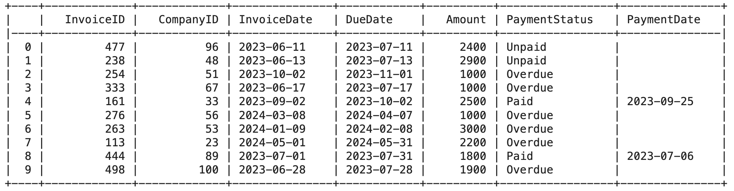
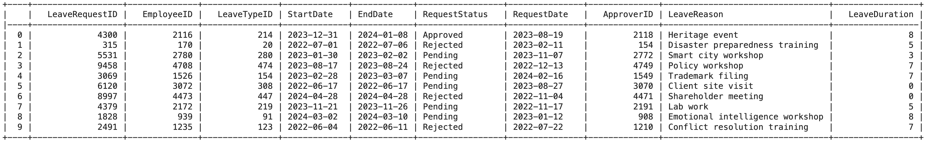
Examples
Companies table:
Positions table:
Payroll records table:
Invoices table:
Leave requests table:

Slide 9
Building our agent

Slide 10
Deciding on framework, model and architecture
Decision | Considerations / questions | Choice
 | Can we perform the same sequence of steps to answer all possible queries? Is there any scenario where we would need to perform iteration? | Agentic architecture. Depending on the complexity of the query, we would likely need to perform different sequences to generate the right SQL command. We would also need to iterate if the LLM generates an incorrect command which results in an error response from the database
 | Autonomous: LLM has full power to determine the control flow of the app Custom: Developer plans the control flow, but LLM has ability to influence the control flow by routing between different steps How should we trade off flexibility vs reliability? | Both options could be viable. We will try an autonomous architecture first as we think it is more efficient. If we were to plan the control flow, we would need to ensure that it can cater for the most complex queries. This results in redundant processes for most queries which may potentially lead to lower performance and higher cost/latency
 | Model cost and size Closed-source or open-source Overall model performance across public benchmarks Data security requirements Choice of cloud provider / access to GPUs | Based on our specific needs (e.g. data security requirements, cloud infrastructure), we will identify a list of leading models of different sizes from different providers. Prior to deployment, we will conduct an evaluation of all shortlisted models using a custom Q&A dataset. We will then select the winning LLM based on accuracy, cost and latency For our prototype, we will prioritize accuracy first and go with a large, top-performing model - GPT 4o
 | Examples: LangChain LlamaIndex AutoGen | LangChain. It has decent documentation / resources, a large developer community, and offers a variety of ready-made tools useful for SQL-related tasks. It is also interoperable with all leading LLMs. Its recent LangGraph extension enables us to build agents with persistence (long-term memory) easily. This is crucial in enabling conversational flow with users, human-in-the-loop interactions and ability to debug / modify agent behavior
Choice of architecture - agentic or non-agentic?
Choice of agent type – autonomous or custom?
Choice of LLM
Choice of software framework

Slide 11
ReAct agent
ReAct = Reasoning + Action
We will start by binding a set of tools to our LLM and pass a prompt that contains information about its role and some guidance on how best to use certain tools
The LLM will then reason and decide which tool it should use. We will trigger the tool, retrieve the output and append it to the prompt. We pass the updated prompt to the LLM for it to observe the output, and it proceeds to reason again. This continues in a loop until the LLM is ready to produce a response to the user’s question
Invoke tool
Tool call response
Start
Prompt LLM
Bind tools to LLM
Return response to user
End
Content response

Slide 12
Designing tools for our agent
Tool | Purpose | Output
sql_db_query_checker | Get LLM to check if a SQL command is syntactically correct and fix any errors if needed | SQL command that is syntactically valid and ready for execution
sql_db_query | Connect to database and execute query | Database response to the query
sql_db_schema | Gives LLM information on the structure and contents of a table | Column names, data types and sample rows from the table
get_tables_descriptions | Gives LLM basic idea of the contents stored in each table | A short description of each table in the database, e.g. PerformanceReviews: Contains information about performance reviews submitted by our customers' employees
get_today_date | Enables LLM to know the date today so it can generate correct command for queries involving date filters | Today’s date
get_distinct_values_from_table | Enables LLM to know all distinct values in each text column in a table so that it can better answer queries involving text-related comparisons | A list of unique values for each text column in a table

Slide 13
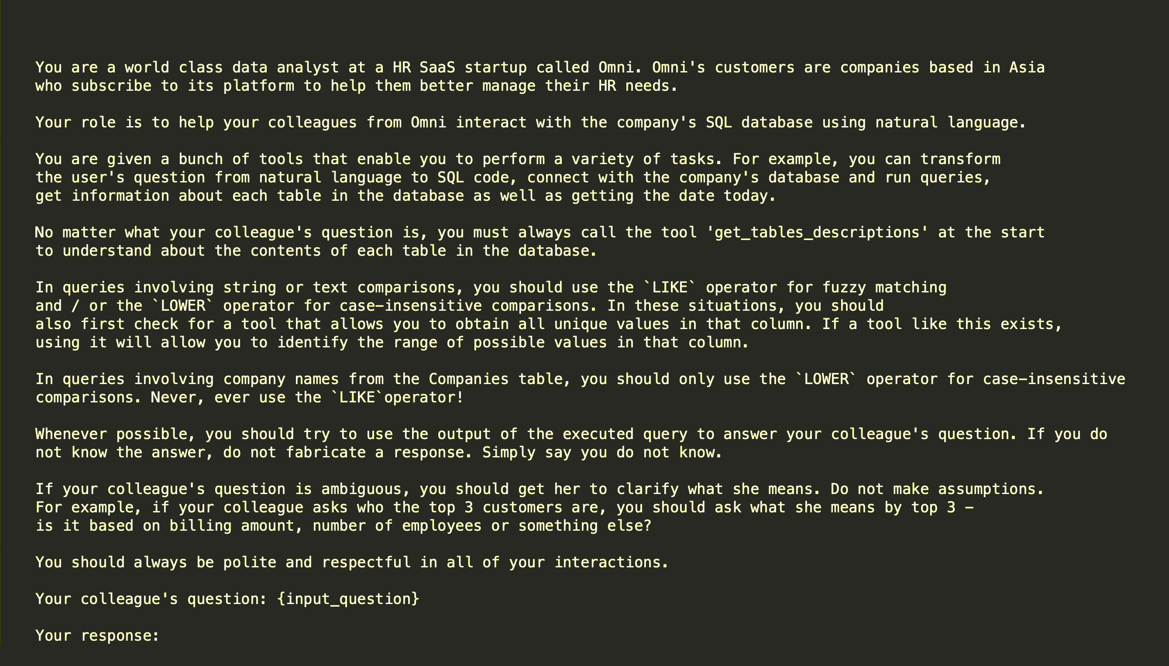
System prompt

Slide 14
Demos

Slide 15
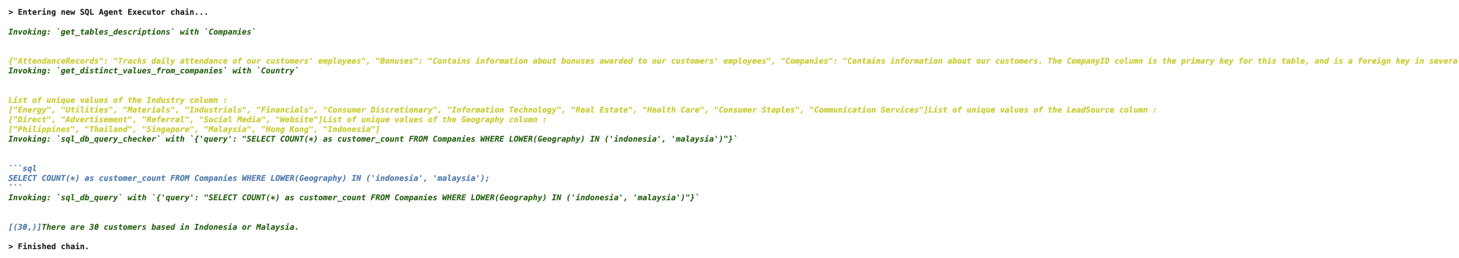
Q: How many customers are based in indo or msia?

Slide 16
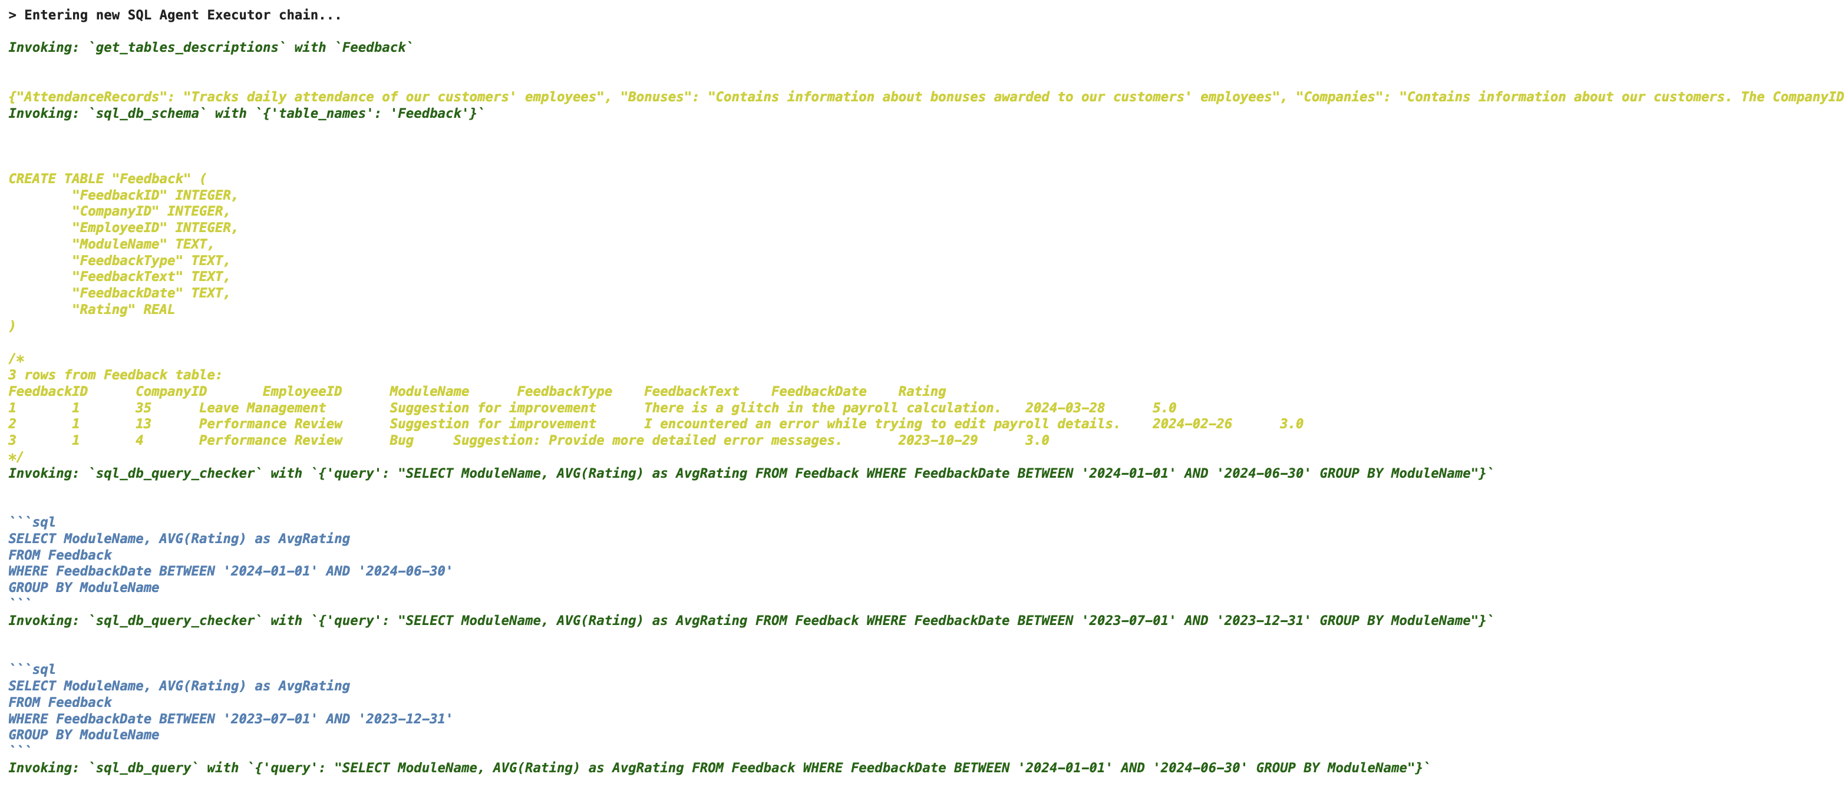
Q: Show me the average feedback score for each module in the first half of 2024. How has it changed compared to the second half of 2023?

Slide 17
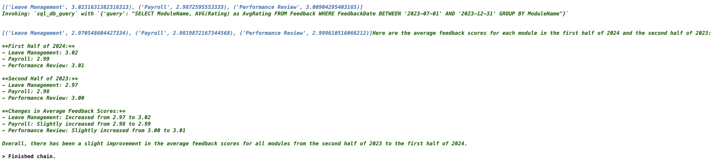
Q: Show me the average feedback score for each module in the first half of 2024. How has it changed compared to the second half of 2023?

Slide 18
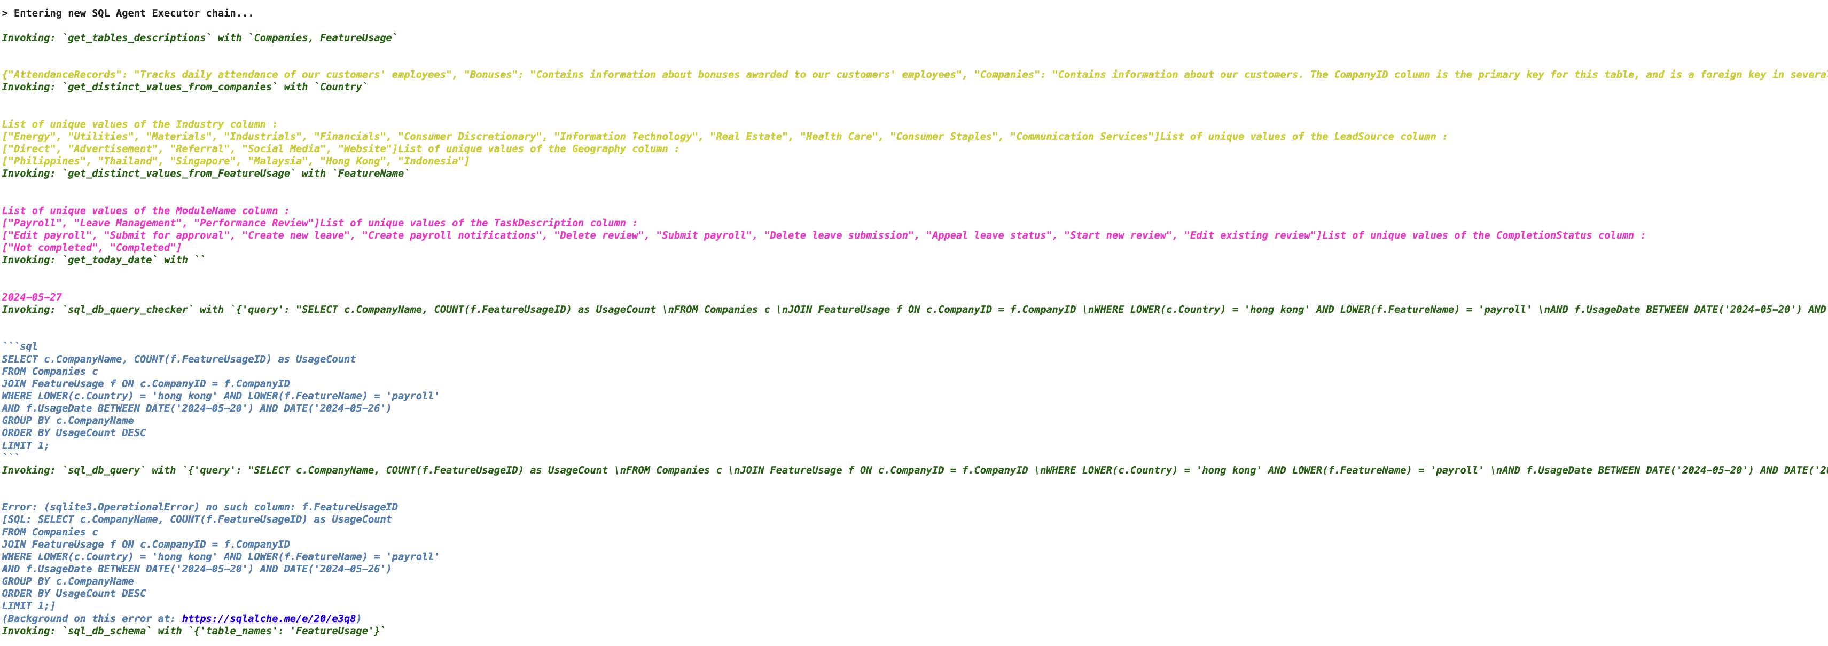
Q: Which customer from HK used payroll module most frequently last week?

Slide 19
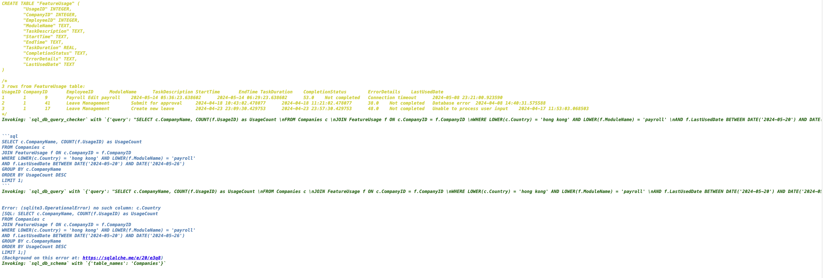
Q: Which customer from HK used payroll module most frequently last week?

Slide 20
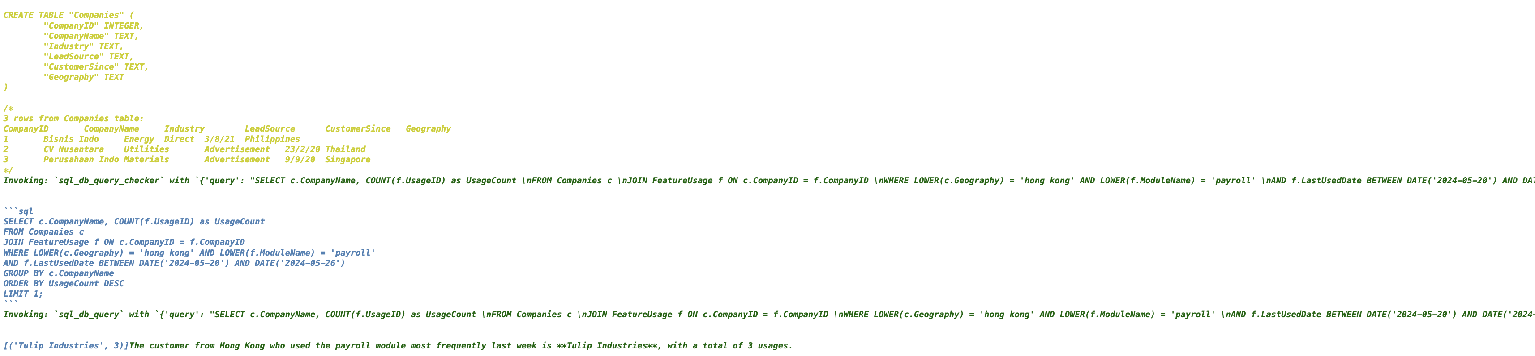
Q: Which customer from HK used payroll module most frequently last week?

Slide 21
Rollout plan

Slide 22
Our plan
Refine prototype
Collect feedback from employees
Prepare evaluation dataset
Deploy chatbot to production
Train employees
Evaluation and select final LLM

Slide 23
Stages and milestones
Stage | Tasks | Milestones | Duration
 | Build web interface for users to interact with chatbot Set up logging system to record all conversations in next stage | Full-fledged web app approved | ~ 1 day
 | Conduct user interviews with a test group of employees across different departments Allow them to interact with chatbot freely and only give them a basic idea of the chatbot’s purpose Observe their interaction patterns with the chatbot and ask them about their experience / needs Log all messages exchanged with chatbot Make refinements to chatbot using feedback obtained | All interviews completed App revisions approved | ~ 2 weeks
 | Prepare a list of 100 questions for evaluation List should include a diverse range of questions with varying degrees of complexity Potential sources: chatbot conversations from previous stage, past data requests made by employees, self-generated questions Data analysts to prepare the correct answer to all questions by generating the correct SQL commands | Evaluation dataset approved | ~ 3 days
Refine prototype
Collect feedback from employees
Prepare evaluation dataset

Slide 24
Stages and milestones
Stage | Tasks | Milestones | Duration
 | For each model, generate responses to all questions in evaluation dataset Compare results across different models in terms of accuracy, cost and latency Select winning model Ensure that accuracy of winning model is 100% | Final LLM approved 100% accuracy on evaluation dataset | ~ 1 week
 | Conduct in-person / virtual sharing sessions for all employees that will be using the chatbot Provide examples of use cases based on department | Sharing sessions completed | ~ 3 days
 | Ensure that chatbot has read permissions only Customize chatbot for different departments so that each department only has access to selected data (optional) | QA completed and approved | ~ 3 days
Evaluation and select final LLM
Train employees
Deploy chatbot to production

Slide 25
Post-deployment

Slide 26
Monitoring chatbot performance and measuring success
After deployment, we want to closely monitor the chatbot’s performance
Log all user questions and chatbot responses
Collect a sample at regular intervals and measure accuracy of the chatbot’s responses
Over time, as we have more confidence in the chatbot, we can reduce the sample size
We will measure success by measuring how often employees can rely on the chatbot for their data needs
Success metric: number of data requests per employee per week
We hope to observe a significant reduction in the number of data requests to the data team
In addition, we will start to track the proportion of employees who use the chatbot per week and we hope to see a much higher level of adoption compared to existing dashboards
We should continue to explore how we can further improve performance of our agent:
Replace LLM with newer, improved models that can improve accuracy and reduce cost
Regularly collect feedback from users to understand their evolving needs
Adding tools that enable the chatbot to provide a variety of responses (in addition to text), e.g. tool that allows agent to execute Matplotlib operations and generate visualizations for the user

Slide 27
Estimated project value
 | Description | Assumptions | Annual impact
 | Value of the time data analysts currently spend responding to data requests and maintaining analytics dashboards | 4 data analysts in the company Annual comp of each data analyst: USD70k % of time spent on these tasks: 40% | ~ USD110k
 | Savings arising from the reduction in subscription fees to BI software providers (eg Tableau) | Current # of Tableau Viewer subscriptions: 50 Annual cost of each Tableau Viewer subscription: USD180 Estimated # of subscriptions we can reduce: 40 | ~ USD7k
 | Cost of inference for GPT 4o | Estimated cost per chatbot interaction: ~USD0.05 (based on OpenAI’s current pricing policy for GPT 4o and the estimated average token usage per interaction) # of employees given access to chatbot: 70 # of chatbot interactions per employee per month: 50 | ~ USD2k (-)
Labour cost savings
Subscription fee savings
Cost of running chatbot
~ USD115k

Slide 28
Beyond direct cost savings …
We believe that the indirect value of this project is far greater than the direct cost savings
Giving employees instant access to accurate and relevant data would enable them to make informed decisions quickly, resulting in higher productivity and improved decision-making
Creating an environment of data transparency and empowering team members with the tools to access data independently can improve employee engagement, leading to a more motivated workforce
By helping employees gain more access to data, they can develop a deeper and more holistic understanding of the business and may be better positioned to produce innovative ideas that can create value for the organization
What we are most excited about though, is how this can propel us in our journey to becoming an AI-first organization
The learnings that we gain from taking this first step will be invaluable in building future agentic systems across other functions, and can potentially unlock multi-agent workflows that can perform complex, multifaceted tasks

Slide 29
Example of multi-agent collaboration
Customer support agent that resolves customer queries
Database agent
Ticket created with user question
Routing to relevant workflow based on question type
Retrieve customer data from database
Generate response
Yes
Check if retrieved data and policy are sufficient to answer question
Identify relevant policy from internal documents
Forward ticket to human support agent
No

